Slide 1
Stereo Fusion using a Refractive
Medium on a Binocular Base
Seung-Hwan Baek Min H. Kim
KAIST
Notes:
Hi,
My name is seung-hwan baek, and I’m going to present a talk “stereo fusion using a refractive medium on a binocular Base.”

Slide 2
Binocular Stereo
Object
Wide-baseline system
  + High depth resolution
  - High probability of false matchings
Narrow-baseline system
  + Low probability of false matchings
  - Low depth resolution
Depth
Optical center 1
Optical center 2
Focal length
Baseline
Notes:
Binocular stereo, which is one of the most popular ways to estimate depth, utilizes two cameras
Disparity is the displacement between the corresponding pixels projected from an object, and it depends on the depth of the object, the focal length of the camera, and the baseline, which is the distance between the cameras.
Wide-baseline reserves many pixels for disparity, therefore it enables us to estimate depth with high depth resolution, however it increases the probability of false matching due to the wide search range of correspondence.
In contrast, narrow-baseline gives less false matchings while providing low depth resolution.
----- Meeting Notes (11/2/14 23:26) -----
공식 relation 설명

Slide 3
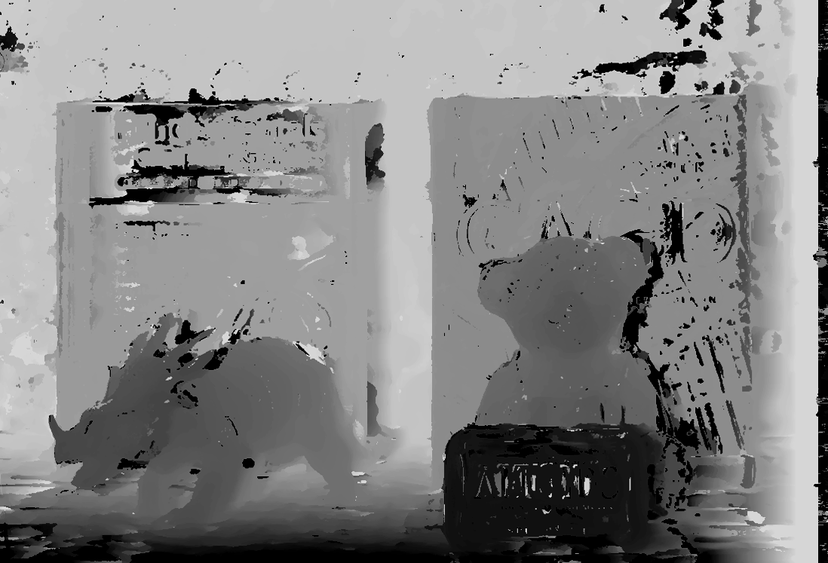
Objectives
Wide-baseline binocular stereo
Achieving a high depth resolution
Reducing spatial artifacts
Notes:
Wide-baseline binocular stereo system produces a depth map with high depth resolution.
However, there are some spatial artifacts.

Slide 4
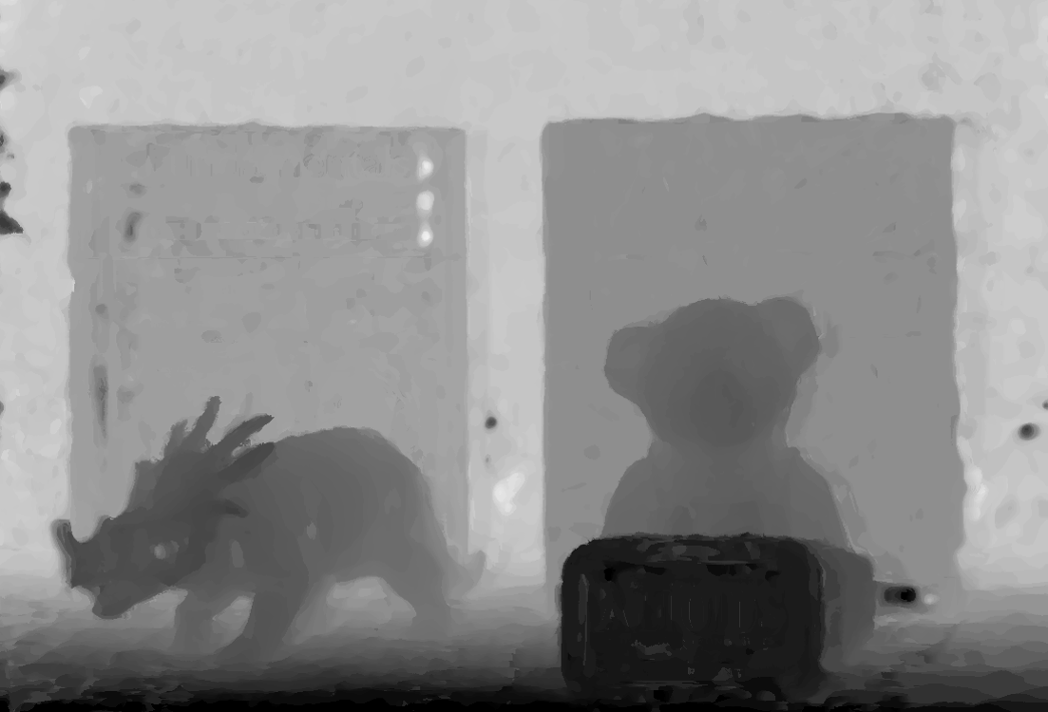
Objectives
Our proposed method
Achieving a high depth resolution
Reducing spatial artifacts
Notes:
Our goal is to mitigate the spatial artifacts problem while maintaining the high depth resolution.

Slide 5
Refractive Stereo
Refractive disparity
Essential line
Image
plane
Scene
Image plane
Essential point
Notes:
One other way to extract depth is refractive stereo which estimates depth from the change of the light direction by refraction.
The scene point p projects into a pixel pd on the image plane.
Now, let’s assume that we place a refractive medium in front of the camera where the normal vector of the medium intersects with the image plane at a point e.
E is called as an essential point.
Now the ray from the object p is refracted by the medium and projects into a different pixel pr.
One interesting point is that the pr, the pd and the e are collinear at a line called essential line.
Then, the refractive disparity, which is the distance between the pd and pr.
By estimating this refractive disparity we can recover the depth of p.
Note that refractive stereo usually presents a smaller disparity than traditional binocular stereo.

Slide 6
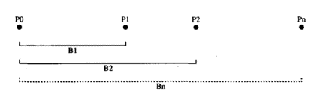
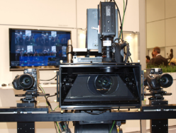
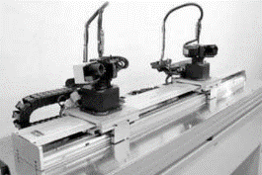
Previous Work: Multi-Baseline Stereo
[Okutomi and Kanade 1993]
First multi-baseline stereo
Cost volume design for multi-baseline stereo
[Zilly et al. 2013]
Narrow- and wide-baseline stereo with four cameras
[Nakabo et al. 2005]
Scene-dependent baseline adjustment
Notes:
Okutomi and Kanade firstly proposed the multi-baseline stereo method, and cost volume design for this setup
Nakabo et al. adjust the baseline interactively depending on the scene.
Zilly et al. Utilized four cameras to form a narrow- and a wide-baseline system producing 3D video data in real-time.

Slide 7
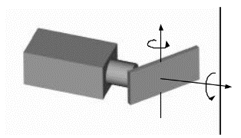
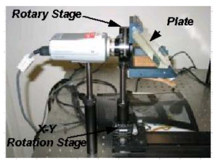
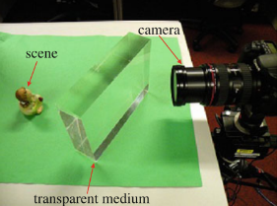
Previous Work: Refractive Stereo
[Gao and Ahuja 2004]
Rotating the medium in a vertical axis
Refractive calibration
[Gao and Ahuja 2006]
Rotating the medium
[Chen et al. 2012]
Calibrating the unstructured medium
Notes:
Gao and Ahuja proposed a refractive stereo system which rotates the medium in a vertical axis and they also proposed refractive calibration method to find essential points using optimization.
Gao and Ahuja rotate a medium in front of a camera, and acquire elaborate depth information
Chen et al. proposed a calibration method for the unstructured medium and compute depth using SIFT

Slide 8
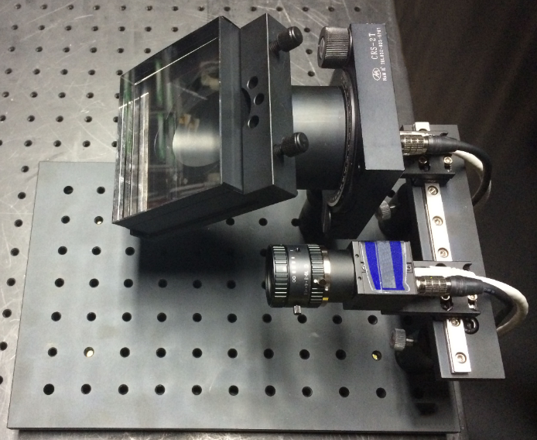
Our System Prototype
Rotary
stage
Camera
Trans.
medium
Camera
Notes:
This is the prototype of our system.
First, on the base of binocular stereo system, we place a transparent medium in front of a camera equipped with a rotary stage.
We take multiple refracted images by rotating the medium from the refractive camera, and a single image from the other camera.

Slide 9
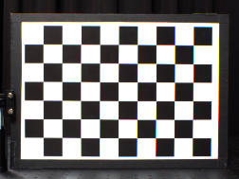
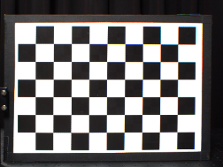
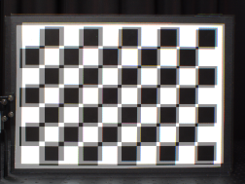
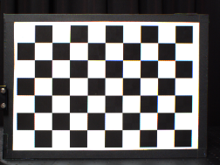
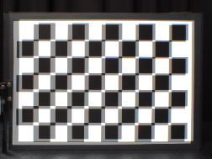
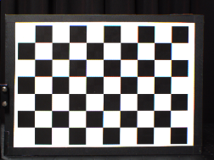
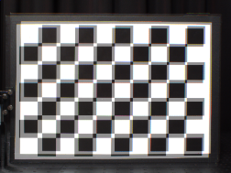
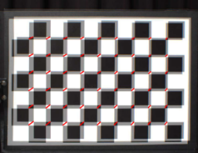
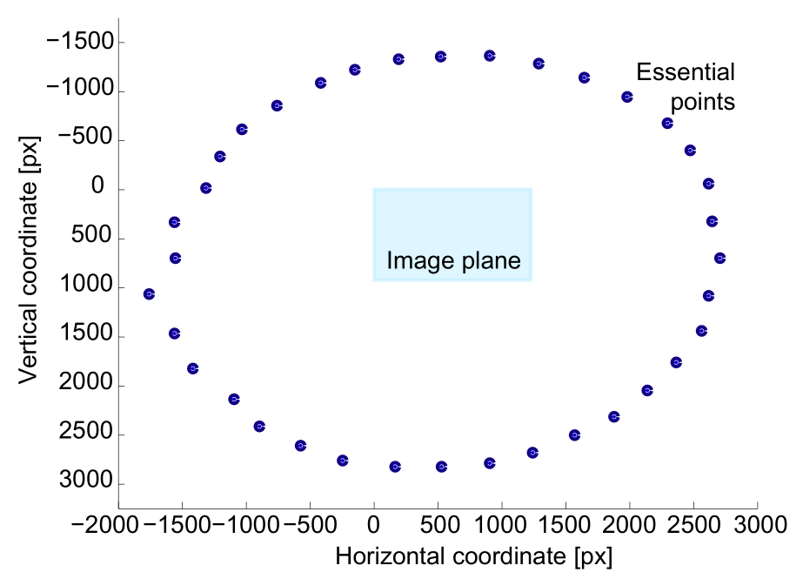
Refractive Calibration
Without the medium
(Unrefracted image)
With the medium
(Refracted images)
Overlaped images
Connecting points
Essential point estimation
Essential points for 36 poses
…
Notes:
Refractive calibration is the process for estimating the essential points for specific poses of the medium.
We first capture a chessboard with/without the medium for each pose of the medium.
After extracting corners on the images, we superpose the refracted and unrefracted images.
Then, we draw a line connecting the corresponding points for each corner.
The essential point of a pose is computed as the arithmetic mean of the line-by-line intersection points.
In our experiment, we pre-calibrated 36 essential points with 10 degrees interval.

Slide 10
Refractive Stereo
True depth:
Notes:
Lets assume that the object for the pixel pd has a depth z.
When there is a medium for a pose with essential point e1, the ray from the object is refracted, and projects into the essential line connecting the e1 and the pd.
For the calibrated essential points, the colors of the refracted points are collected, then the similarity of the colors would high when the lambertian surface assumption holds.

Slide 11
Refractive Stereo
True depth:
Hypothetical depth:
Similarity measure
Epanechnikov kernel
where
Notes:
When we test pixel pd has a depth z prime, which is different from the true depth, the colors of the corresponding refracted pixels have low similarity.
We set the similiarty cost as a sum of epanechnikov kernels of deviations.
By selecting the best depth z which maximizes the similarity cost, we estimate the refractive depth map.

Slide 12
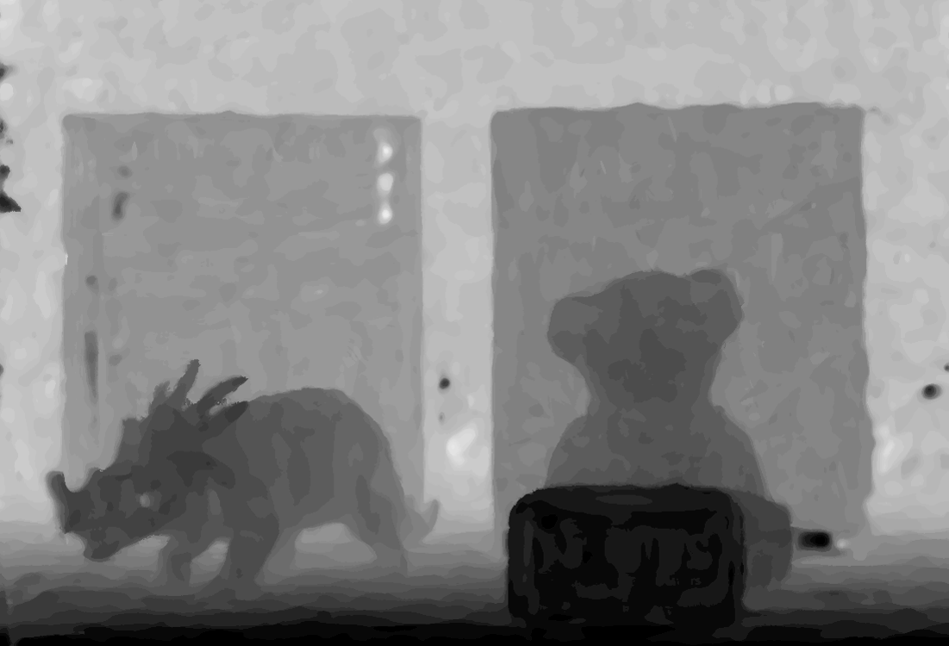
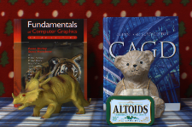

Synthetic Direct Image
Refractive depth map
Refracted images
Synthetic direct image
Notes:
Note that we do not capture scene without the medium on the refractive module.
In order to utilize the binocular setting, we need to recover the synthetic direct image using the refractive depth map and refracted images.
For each pixel on a refractive depth map, we compute the positions of the refracted points for target essential points with the estimated refractive depth.
Then, we compute the average color of the refracted pixels on the refracted images, and create
------------------------
Final refractive depth map and synthetic direct image are computed using weighted median filter.
밑에꺼 한줄만 남기고

Slide 13
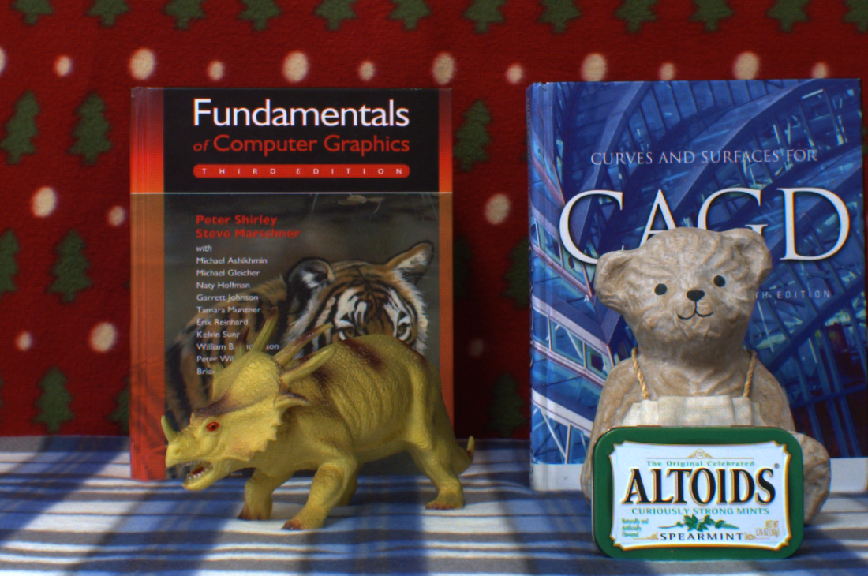
Stereo Fusion
Aggregated cost
Synthetic direct image
Disparity candidate
Image from the other camera
Notes:
Now we have two stereo images, one is synthetic direct image generated by the refractive stereo, and an image from the other camera.
the traditional binocular stereo method can be applied.
In local binocular stereo, the aggregated costs are computed for the all target disparity candidates

Slide 14
Coarse-to-fine Approach
d_{post}
d_{prev}
Search range guide
Aggregated cost
Minimal cost in binocular stereo
Binocular stereo
True disparity
Disparity candidate
Refractive depth map
Our stereo fusion
Notes:
However, as we mentioned, in the case of wide-baseline system, there are some spatial artifacts caused by false matchings.
the true disparity for this pixel is around 200, however the estimated disparity for this red pixel is 160.
In order to solve this problem, we take coarse-to-fine approach to guide the range of correspondence search based on the refractive depth estimate.
In the end, our final results avoid such false matching problem, and estimate the correct depth.

Slide 15

Results
Local binocular stereo
Our stereo fusion
Notes:
Compared to the local binocular stereo, our method achieves a depth map with less spatial artifacts

Slide 16
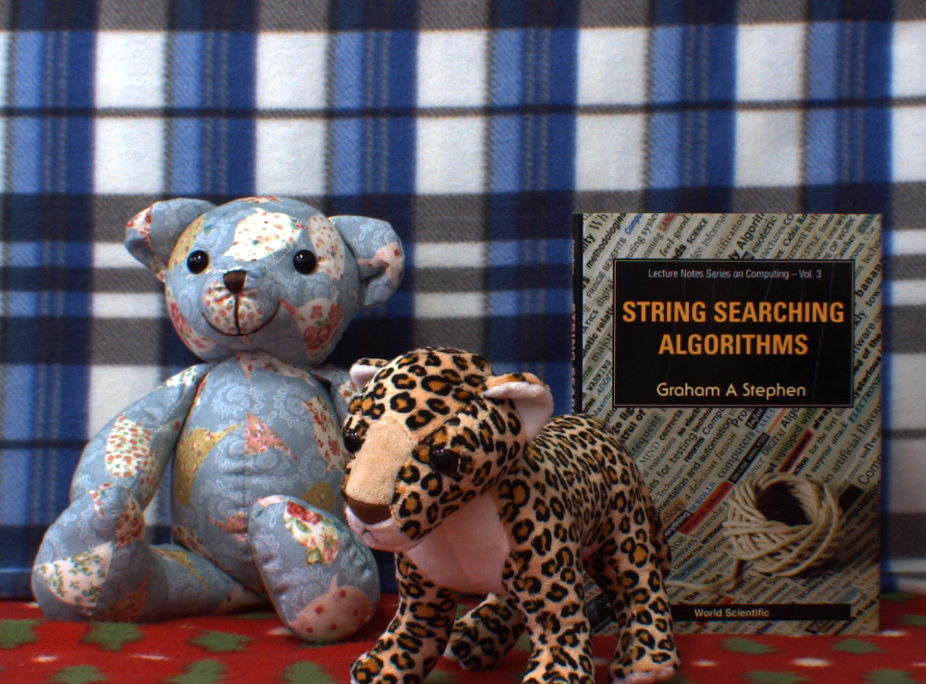
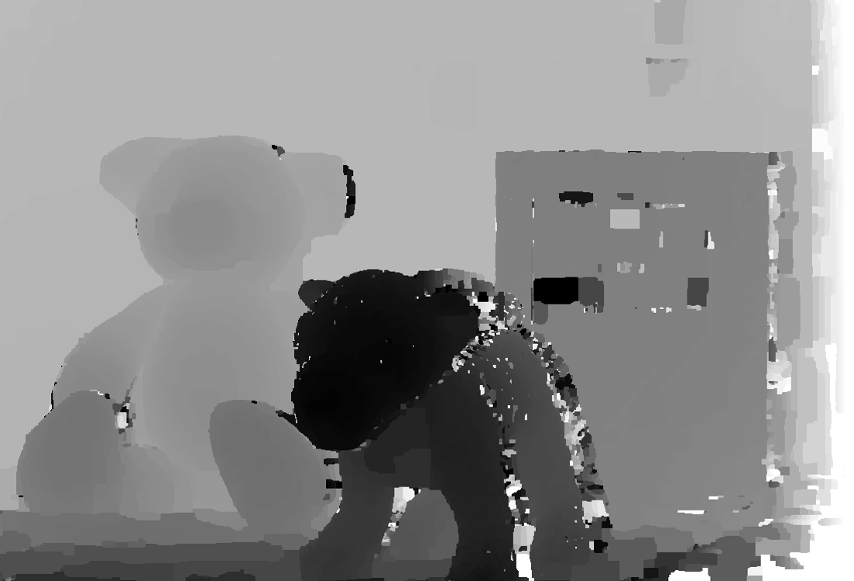
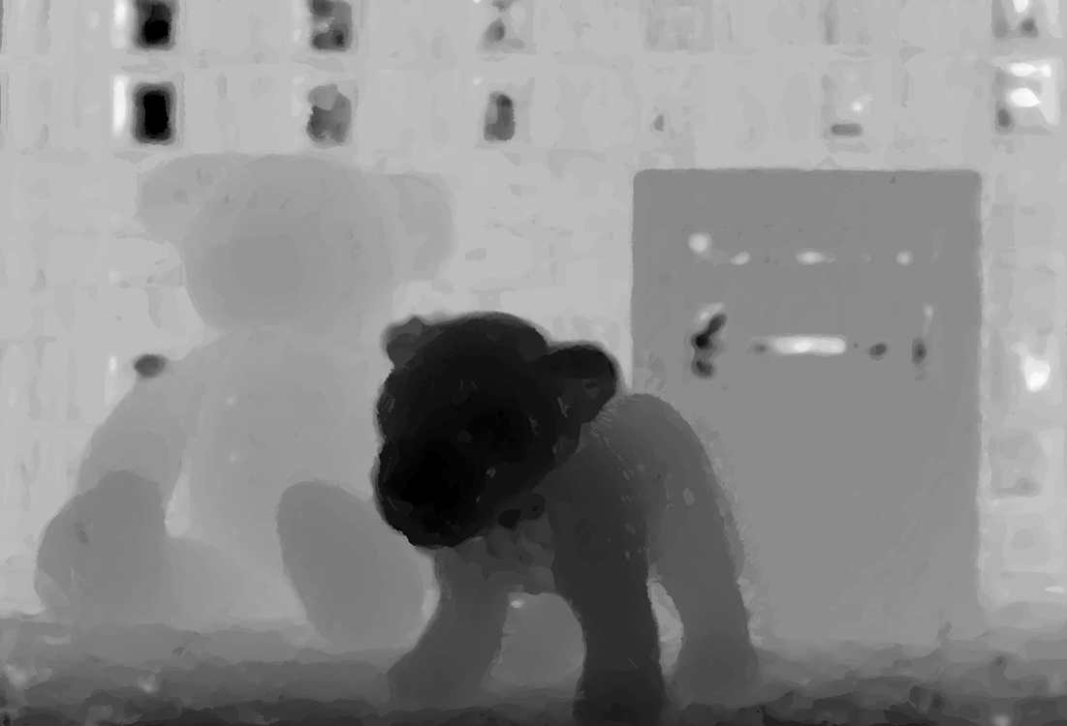
Results
Global binocular stereo
Our stereo fusion
(8 times faster)
Notes:
Also, our method shows 8 times faster than the global binocular stereo with the same depth and spatial resolution while the global stereo algorithm produces elaborate depth map.

Slide 17
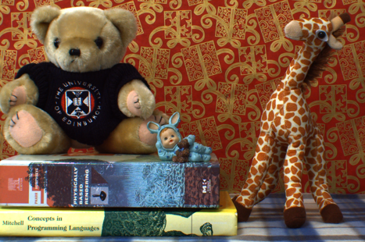
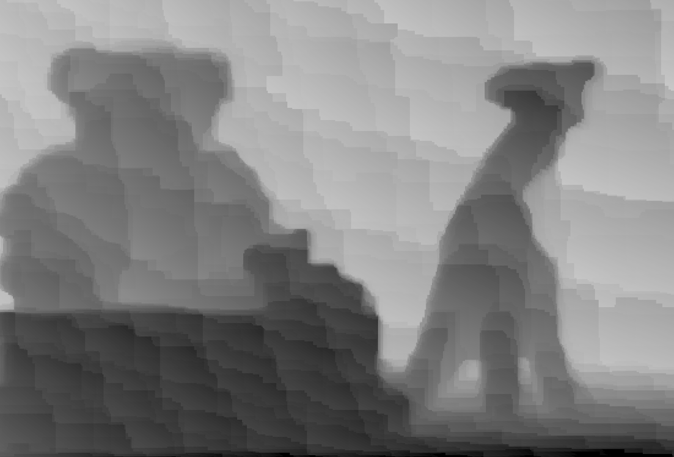
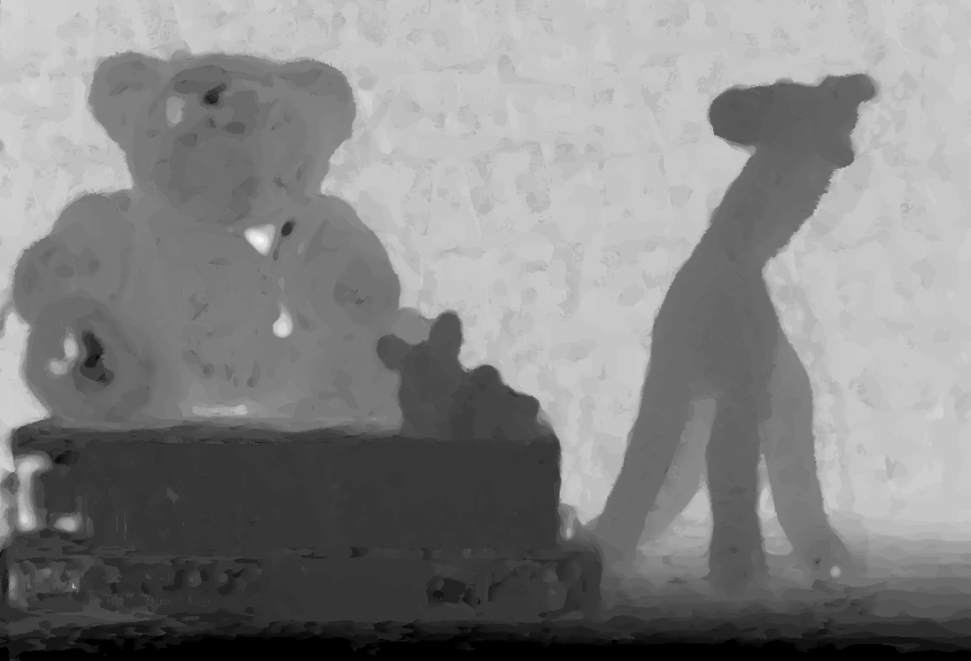
Results
Refractive stereo using SIFT
Our stereo fusion
Notes:
Refractive stereo using SIFT suffers from wavy artifacts and have low depth resolution.
Our method exhibits high depth resolution
----- Meeting Notes (10/28/14 12:54) -----
Wavy artifacts가 어디에서 나오나?
Workflow가 없다

Slide 18
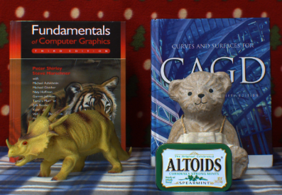
Discussions
Optimal number of refracted images
Notes:
In order to analysis the optimal number of input refracted image, we evaluated RMSE of estimted depths on a planar surface.
RMSE error decreases fast up to six refracted images.
Therefore, we choose the optimal number of refracted images as six.
There are some limitations in our work.
Now our method requires at least one rotation of the medium, and error can be transferred from the refractive depth to the final depth.
----- Meeting Notes (10/28/14 12:44) -----
refracted images

Slide 19
Limitations
At least more than one rotation of the
medium required
Error transfer from the refractive depth to
final depth

Slide 20
Conclusions
Presenting a novel optical design on a binocular
system with a refractive medium
Introducing a stereo fusion workflow combining
refractive and binocular stereo
Acknowledgements
  Gratefully acknowledges Korea NRF grants (2013R1A1A1010165 and 2013M3A6A6073718) and additional support by Microsoft Research Asia and an ICT R&D program of MSIP/IITP (10041313)
Notes:
In conclusion, we presented a novel optical design on a binocular system with a refractive medium and corresponding worf
And also proposed a stereo fusion workflow combining refractive and binocular stereo.
Thanks.

